Slide 1

COMP-SCI 5590 - 0003 Special Topics
Mobile App development

Slide 2
Agenda
RESTful Services
List View, Adapter, Recycling
Multi-Threading, Async Task

Slide 3
RESTful API
An API is an easy way of fetching information from a remote service
A RESTful API uses HTTP requests to GET, PUT, POST and DELETE data.
A browser sends request to and receives response from a server through HTTP.
Some great resources of APIs
1. Programmable Web API Directory
2. Google APIs Explorer
3. Data.gov
https://earthquake.usgs.gov/fdsnws/event/1/

Slide 4
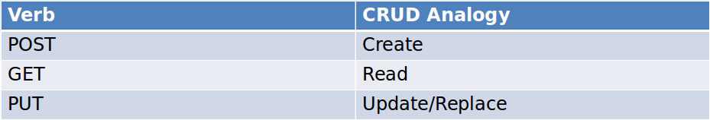
HTTP Verbs

Slide 5
JSON
JSON syntax is derived from JavaScript object notation syntax
Data is in name/value pairs
Data is separated by commas
Curly braces hold objects
Square brackets hold arrays

Slide 6
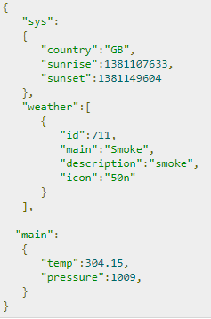


JSON
http://www.tutorialspoint.com/android/android_json_parser.htm
https://developer.android.com/reference/org/json/JSONObject.html

Slide 7
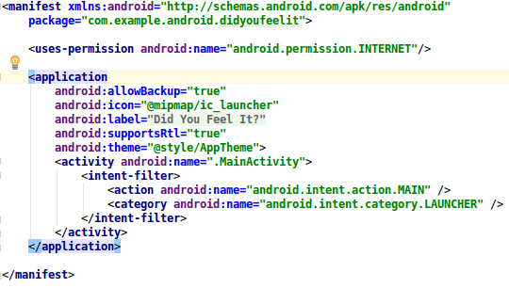
Internet Permission

Slide 8
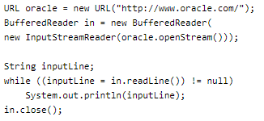
Url Object

Slide 9
What Is a URL?
Uniform Resource Locator
a reference (an address) to a resource on the Internet.
Eg: http://example.com/home/users/profile?name=foo&age=9
protocol
resource path
domain/host
query

Slide 10

Creating a URL
https://developer.android.com/reference/java/net/URL.html

Slide 11
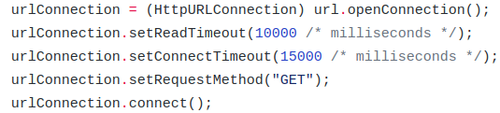
Connecting to a URL

Slide 12
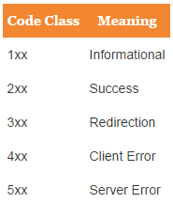
Response Codes

Slide 13
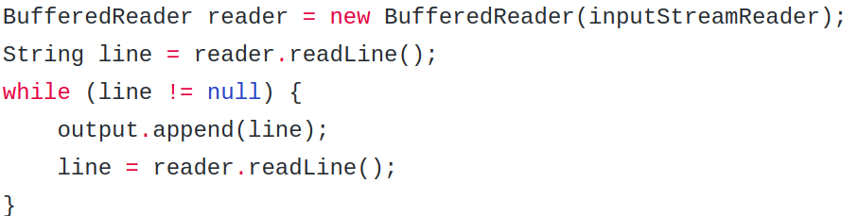
Reading from a URL Connection
InputStreamReader inputStreamReader =
new InputStreamReader(inputStream, Charset.forName("UTF-8"));

Slide 14
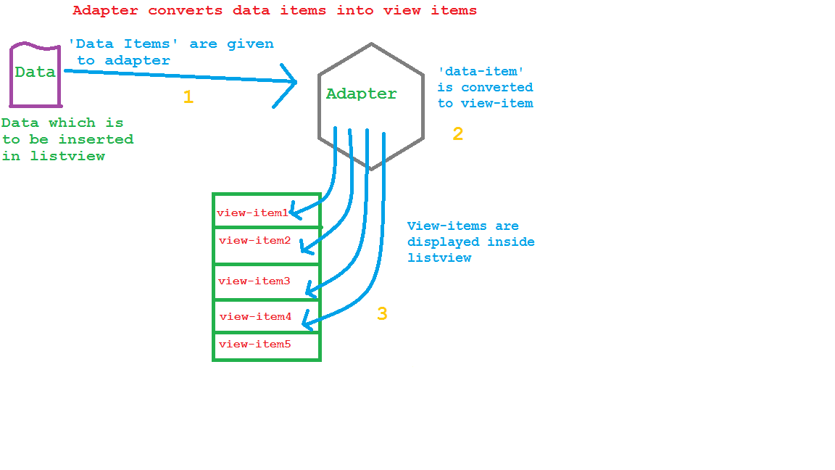
Adapter

Slide 15
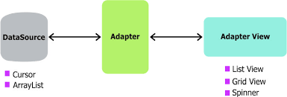
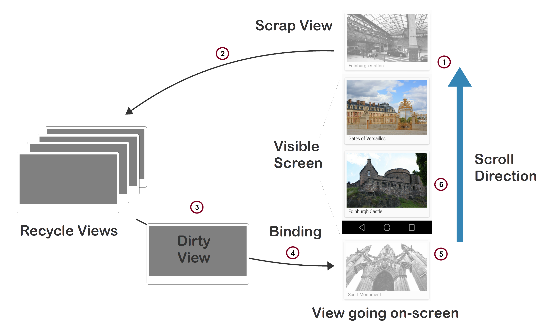
Adapter

Slide 16
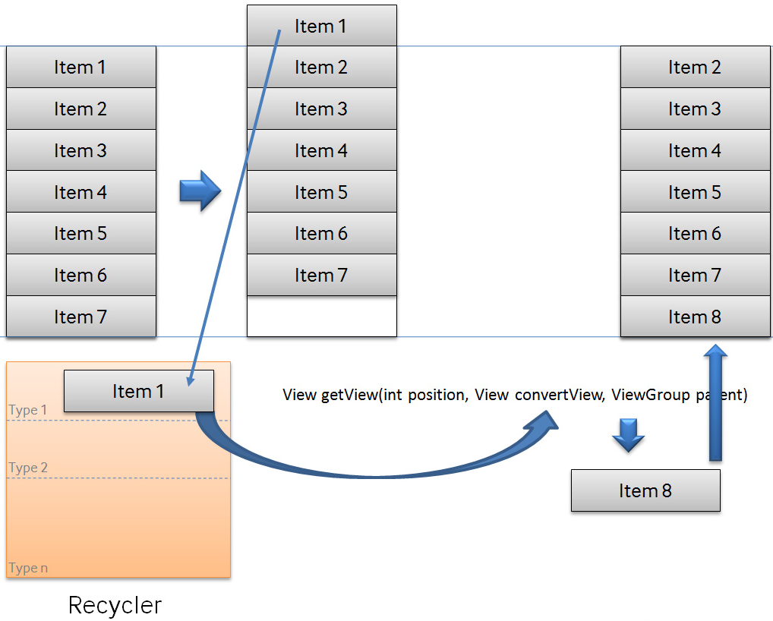
Recycling

Slide 17
Recycling –List View

Slide 18
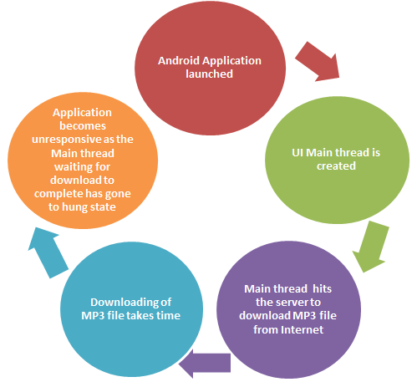
Multi Threading
http://programmerguru.com/android-tutorial/what-is-asynctask-in-android/

Slide 19
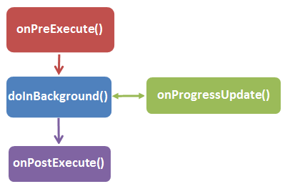
AsyncTask
http://programmerguru.com/android-tutorial/what-is-asynctask-in-android/
https://developer.android.com/reference/android/os/AsyncTask.html

Slide 20
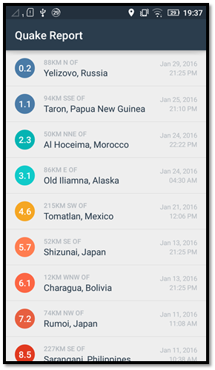
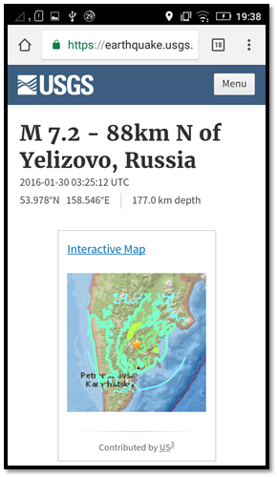
In-Class Programming
Follow the TODO instructions given in the QueryUtils.java,EarthquakeActivity.java
and the AndroidManifest.xml files

Slide 21
References
https://developer.android.com/index.html
https://developers.google.com/android/for-all/vocab-words/
https://classroom.udacity.com/courses/ud843
http://www.tutorialspoint.com/
https://docs.oracle.com/

